Slide 1
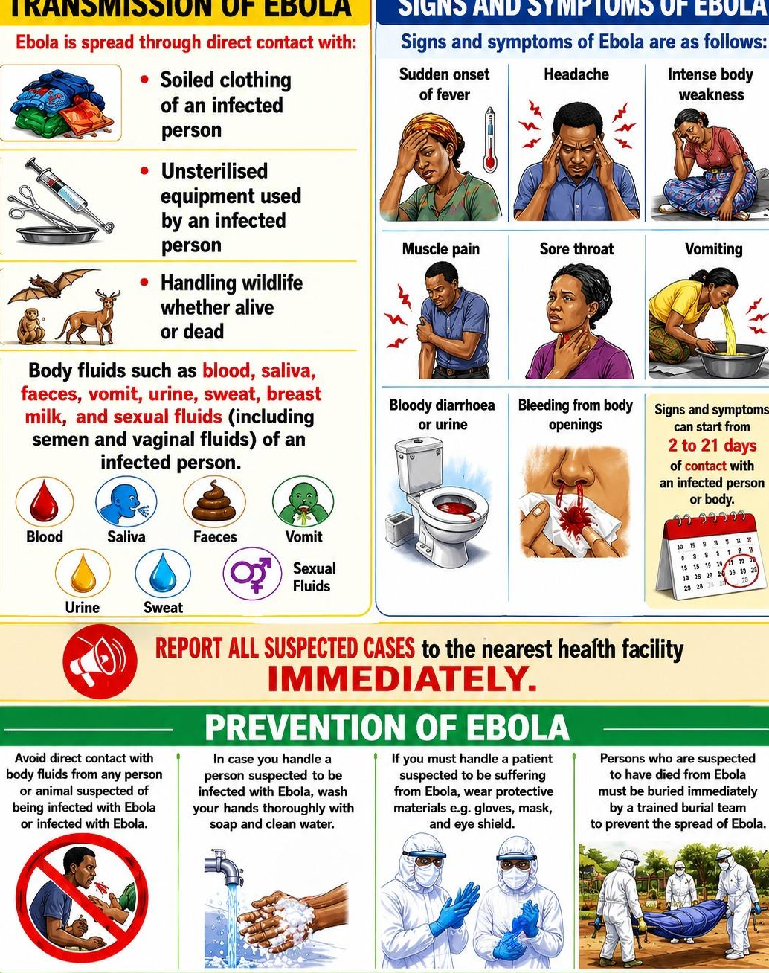
EBOLA
TRANSMISSION OF EBOLA
SIGNS AND SYMPTOMS OF EBOLA
Ebola is spread through direct contact with:
Soiled clothing of an infected person
Sudden onset of fever
Headache
Intense body weakness
Unsterilized equipment used by an infected person
Muscle pain
Sore throat
Vomiting
Handling wildlife whether alive or dead
Body fluids such as blood, sweat, breast milk, and sexual fluids (including semen and vaginal fluids) of an infected person.
Bloody diarrhea or urine
Bleeding from body openings
Signs and symptoms can start from 2 to 21 days after contact with an infected person or body.
Blood
Saliva
Feces
Vomit
Sexual
Fluids
Urine
Sweat
REPORT ALL SUSPECTED CASES to the nearest health facility
IMMEDIATELY.
PREVENTION OF EBOLA
Avoid direct contact with body fluids from any person or animal suspected of being infected with Ebola.
After contact with a person suspected to be infected with Ebola, wash your hands thoroughly with soap and clean water.
If you must handle a patient suspected to be suffering from Ebola, wear protective materials (at minimum gloves, mask, and eye shield.
Persons who are suspected to have died from Ebola must be buried immediately by a trained burial team to prevent the spread of Ebola.
Use this space to add:
Local clinic number
Local health worker
Conference contact
Once this slide has been translated, delete this text and save as PDF before printing.

